Slide 1
Blackjack
Iwp project-Nichita Andrei catalin ETTI FILS-1212A
Coord teacher: sl. dr. ing. Mitrea Dan Alexandru

Slide 2
CONTENT
Programming languages used
objectives
Source code
Comparison with another application
Conclusions
demo

Slide 3
Programming languages used
Java script
Html
C++(for comparison)

Slide 4
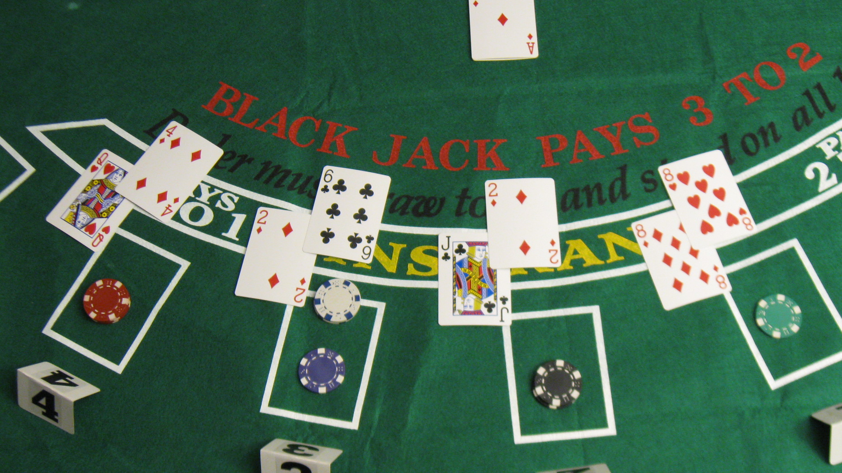

objectives
Simulating and recreating the algortithm of a game of bj
The implementation is made for single-player game of bj (you vs dealer)
Trying to reproduce the real life experience given by a bj game

Slide 5
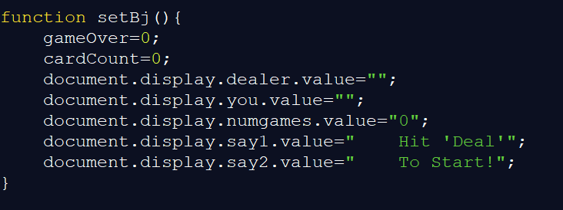
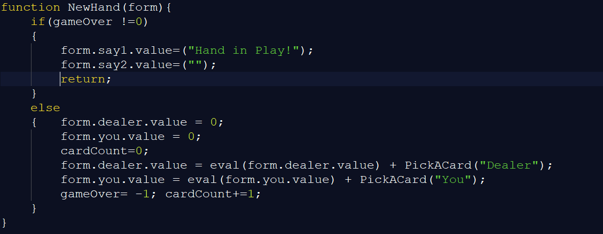
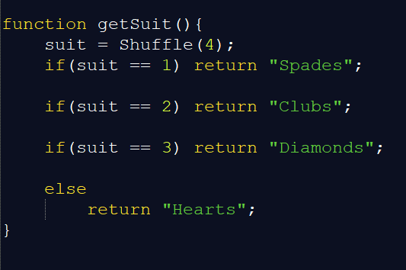
Source code

Slide 6
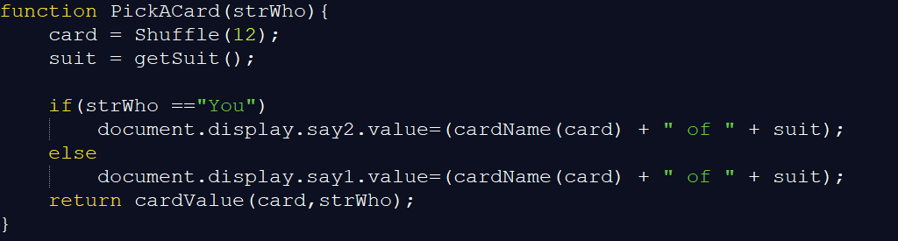
Source code

Slide 7
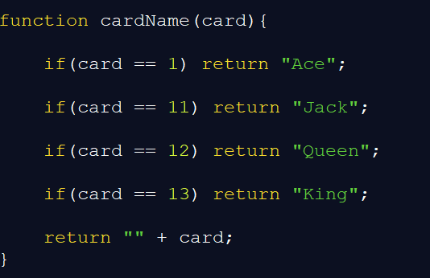
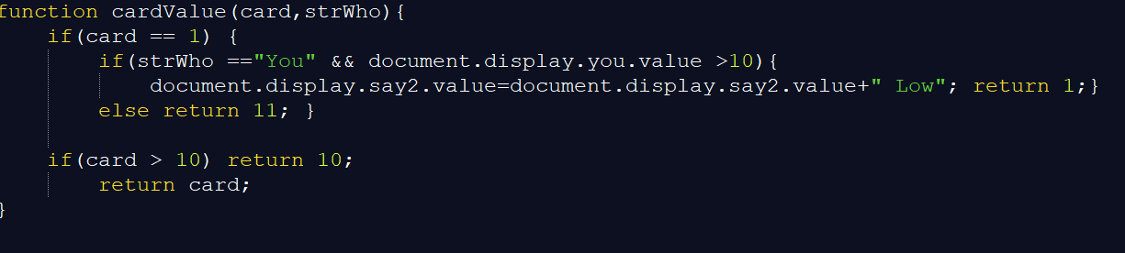
Source code

Slide 8
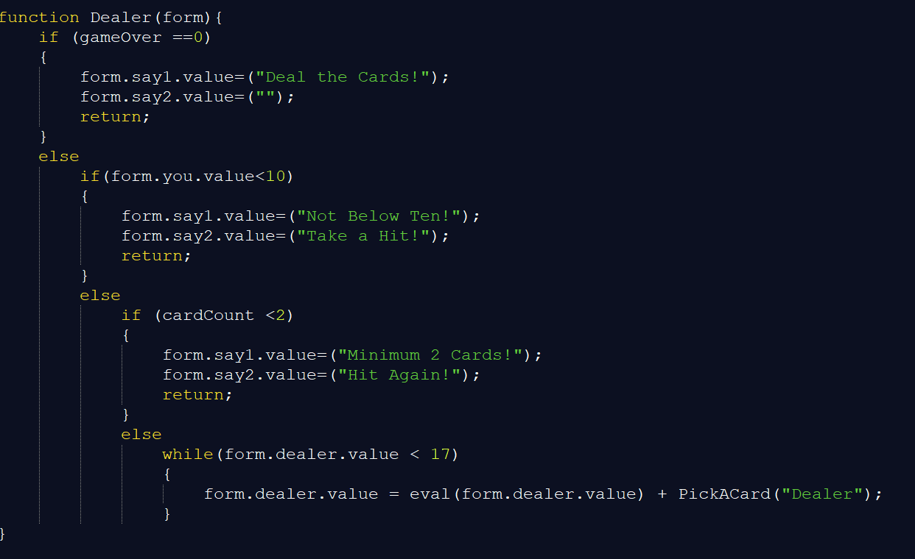
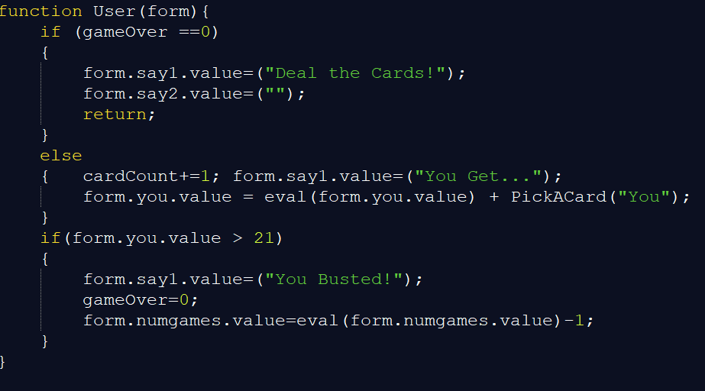
Source code

Slide 9
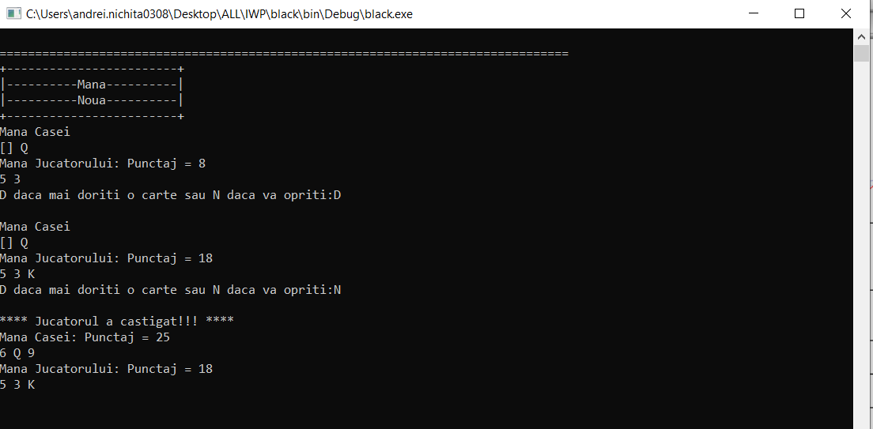
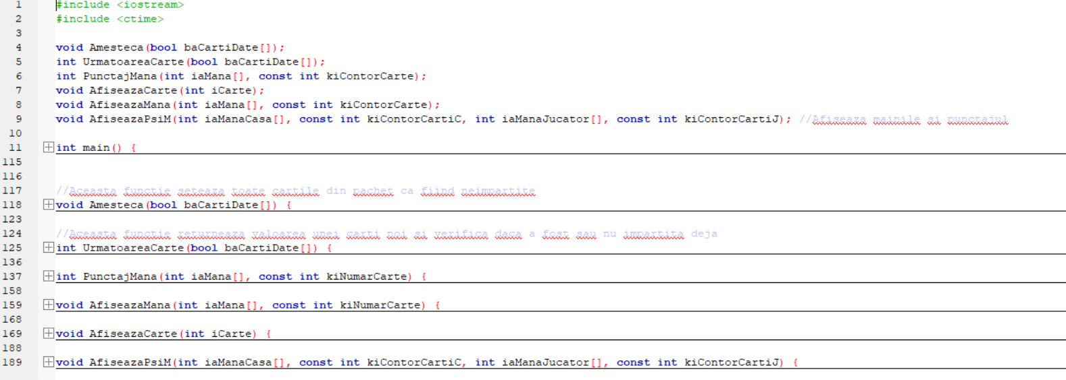
Comparison with another application

Slide 10
features
Closer to the natural language
Can be understood faster (legible)
The display is better than in c++
The user and dealer are defined as functions . In c++ they can be classes or global variables

Slide 11
conclusions
The code can be written easier in javascript than in c++
The display depends a lot of the html/css part of the code
Is more friendly user than c++ coding
For the application development , an interface will be needed
Some design details will be need in order to create the atmosphere of a real game

Slide 12
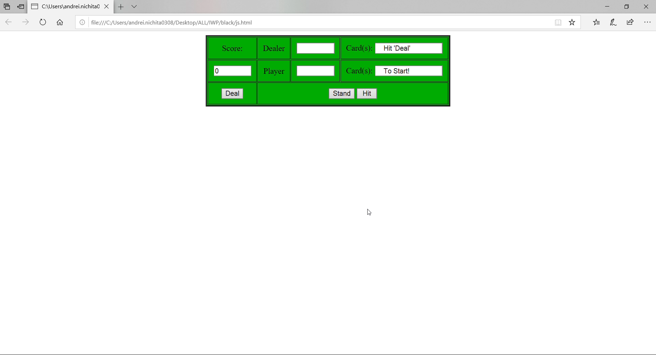
demo

Slide 13
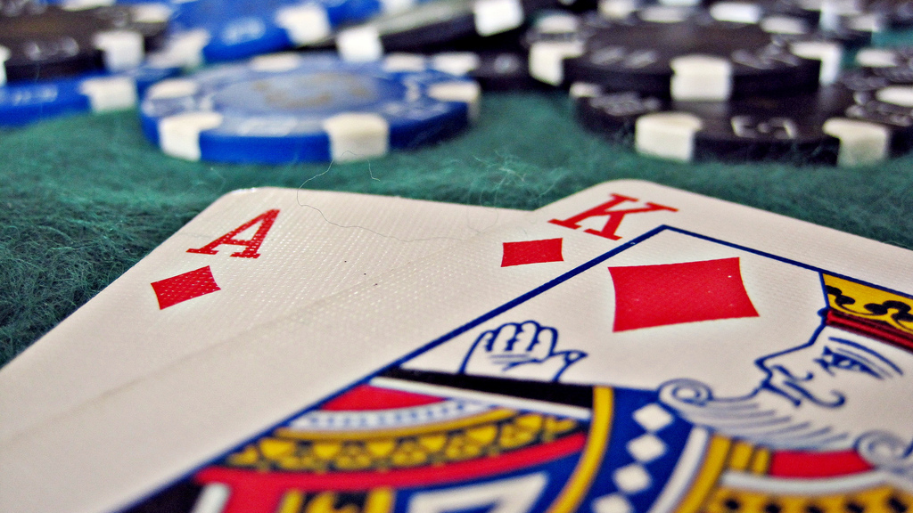
THANK YOU !

